Slide 1
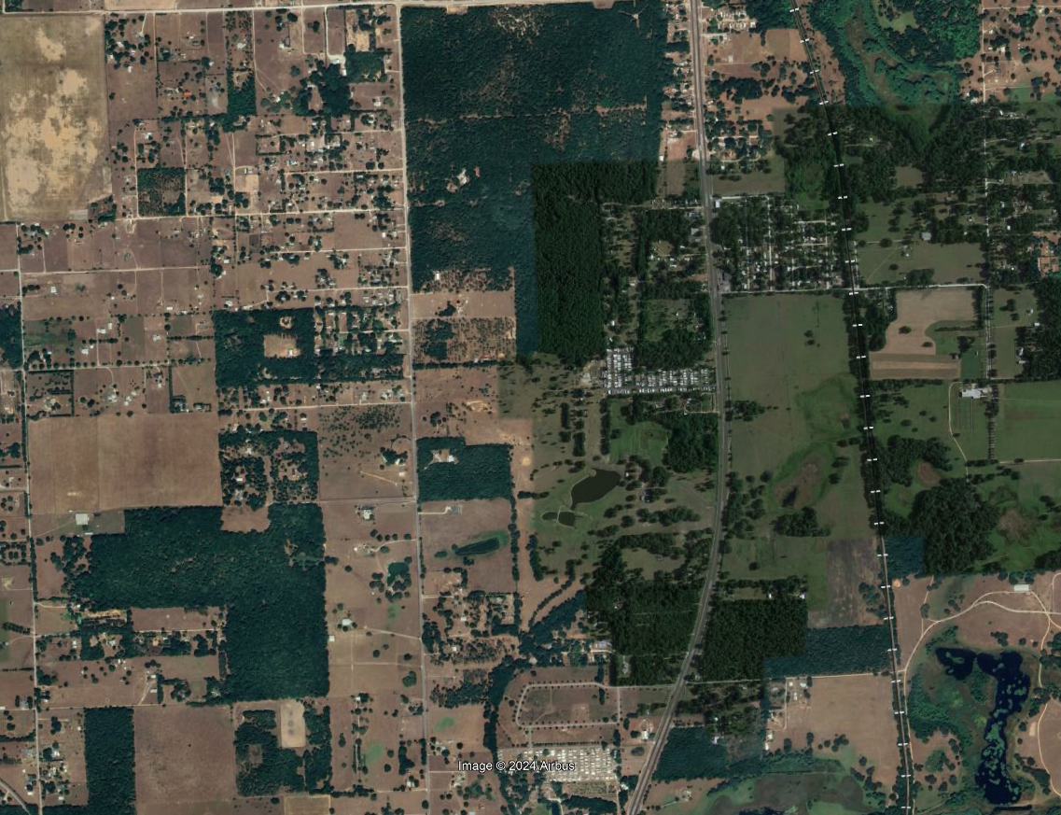



The role of habitat connectivity in wild turkey biology and ecological attributes
Muzi D. Sibiya, Brittany M. Mason, Carolina Baruzzi, Marcus A. Lashley and Corey T Callaghan

Slide 2
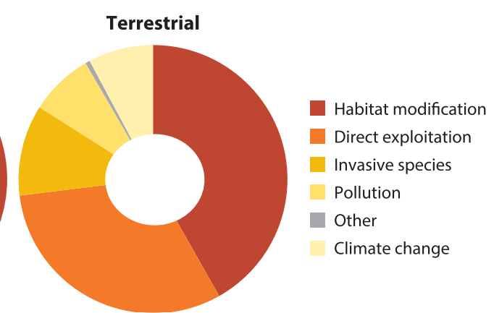
Altered Terrestrial Ecosystem
Land use intensification drive loss of habitat
Leads to fragmented landscapes
Increase animal exposure to a suite of pressures
Young et al, 2016

Slide 3
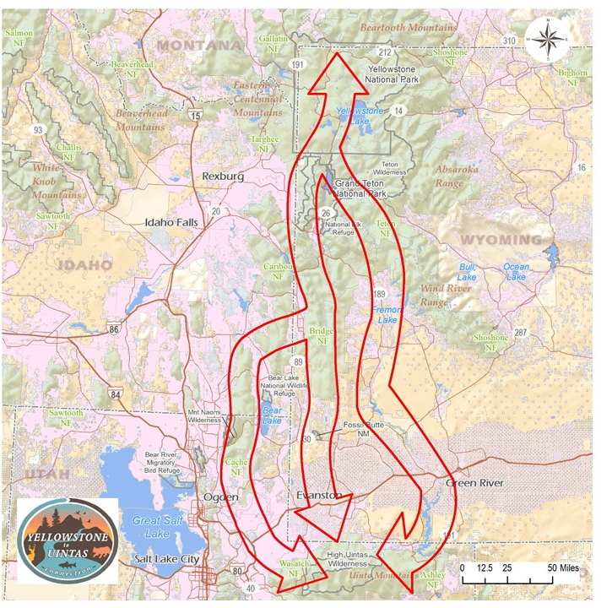
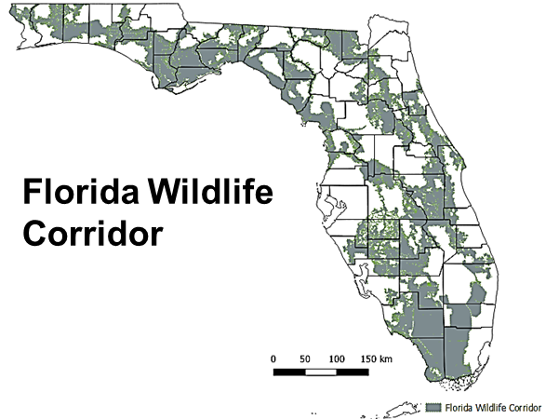
Wildlife corridors and conservation
Yellowstone National Park
Yellowstone to Uintas Corridor
Natural veg between protected areas
Reduces landscape fragmentation
Facilitate animal dispersal
Species use determine corridor role
Conservation efficacy, undetermined
Uintas Wilderness
https://yellowstoneuintas.org/about-us/the-corridor
Notes:
-greater Yellowstone ecoregion to northwest Colorado via the Uinta Mountains

Slide 4

Wild turkey
Pop declines at the species range
Distribution and productivity may respond to landscape processes
Corridors effects not evaluated on wild turkey
Land-use-climate compounded effects in the southeast

Slide 5
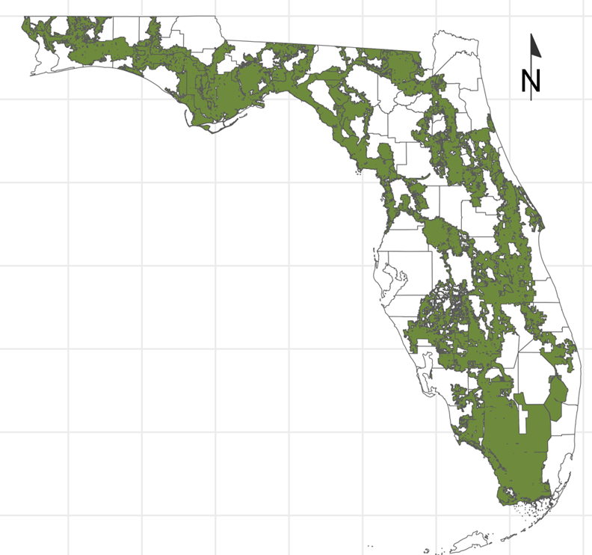
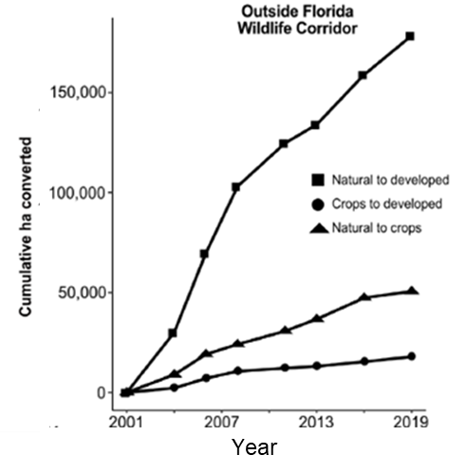
Florida Wildlife Corridor (FLWC)
FL rapidly losing natural veg cover (Daskin et al,2024)
FLWC= public land & private easements
FLWC Act, 2021

Slide 6

Objectives
Investigate dynamics of occupancy and relative abundance
Determine effects FLWC on occupancy, relative abundance and productivity

Slide 7
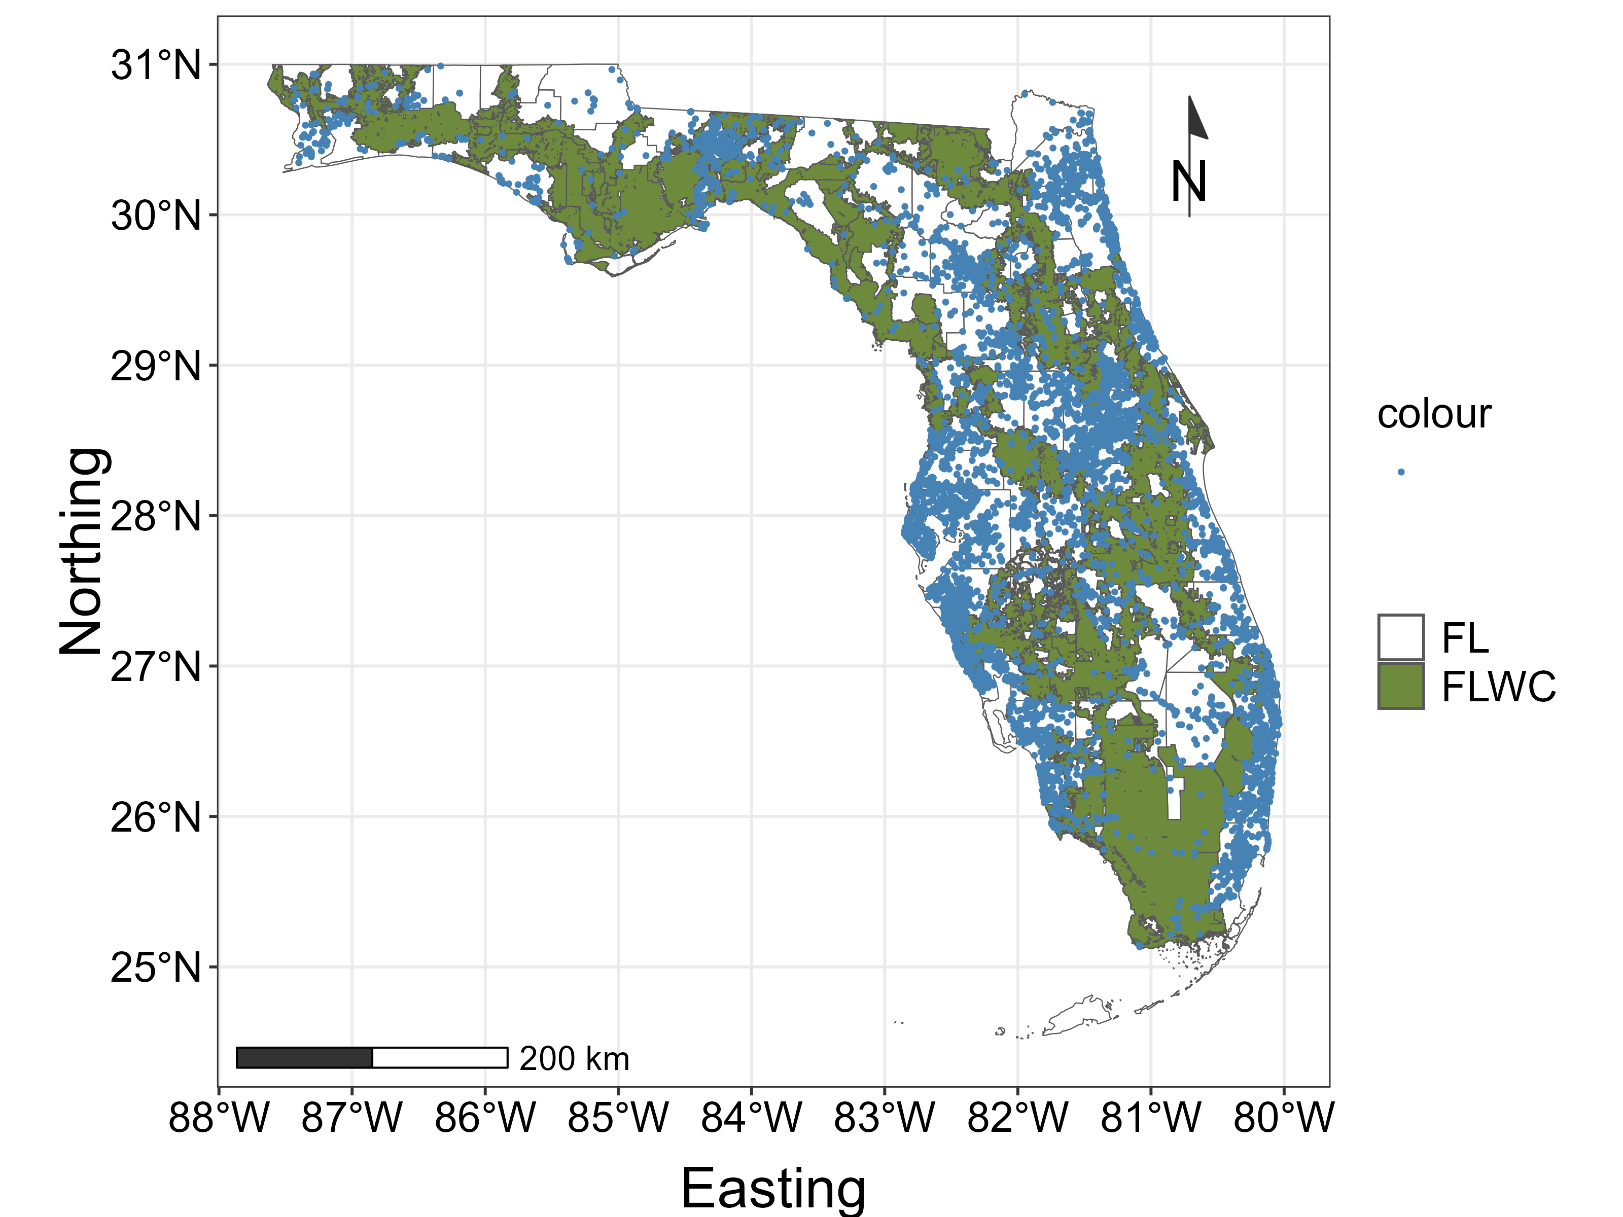
Methods
Brooding data/June-August
2020-2023
Demographic information
Presence/Non-detection
(Presence=3072,
Non-det=17826)
Largest citizen science project
Online bird database
Users follow protocol

Slide 8
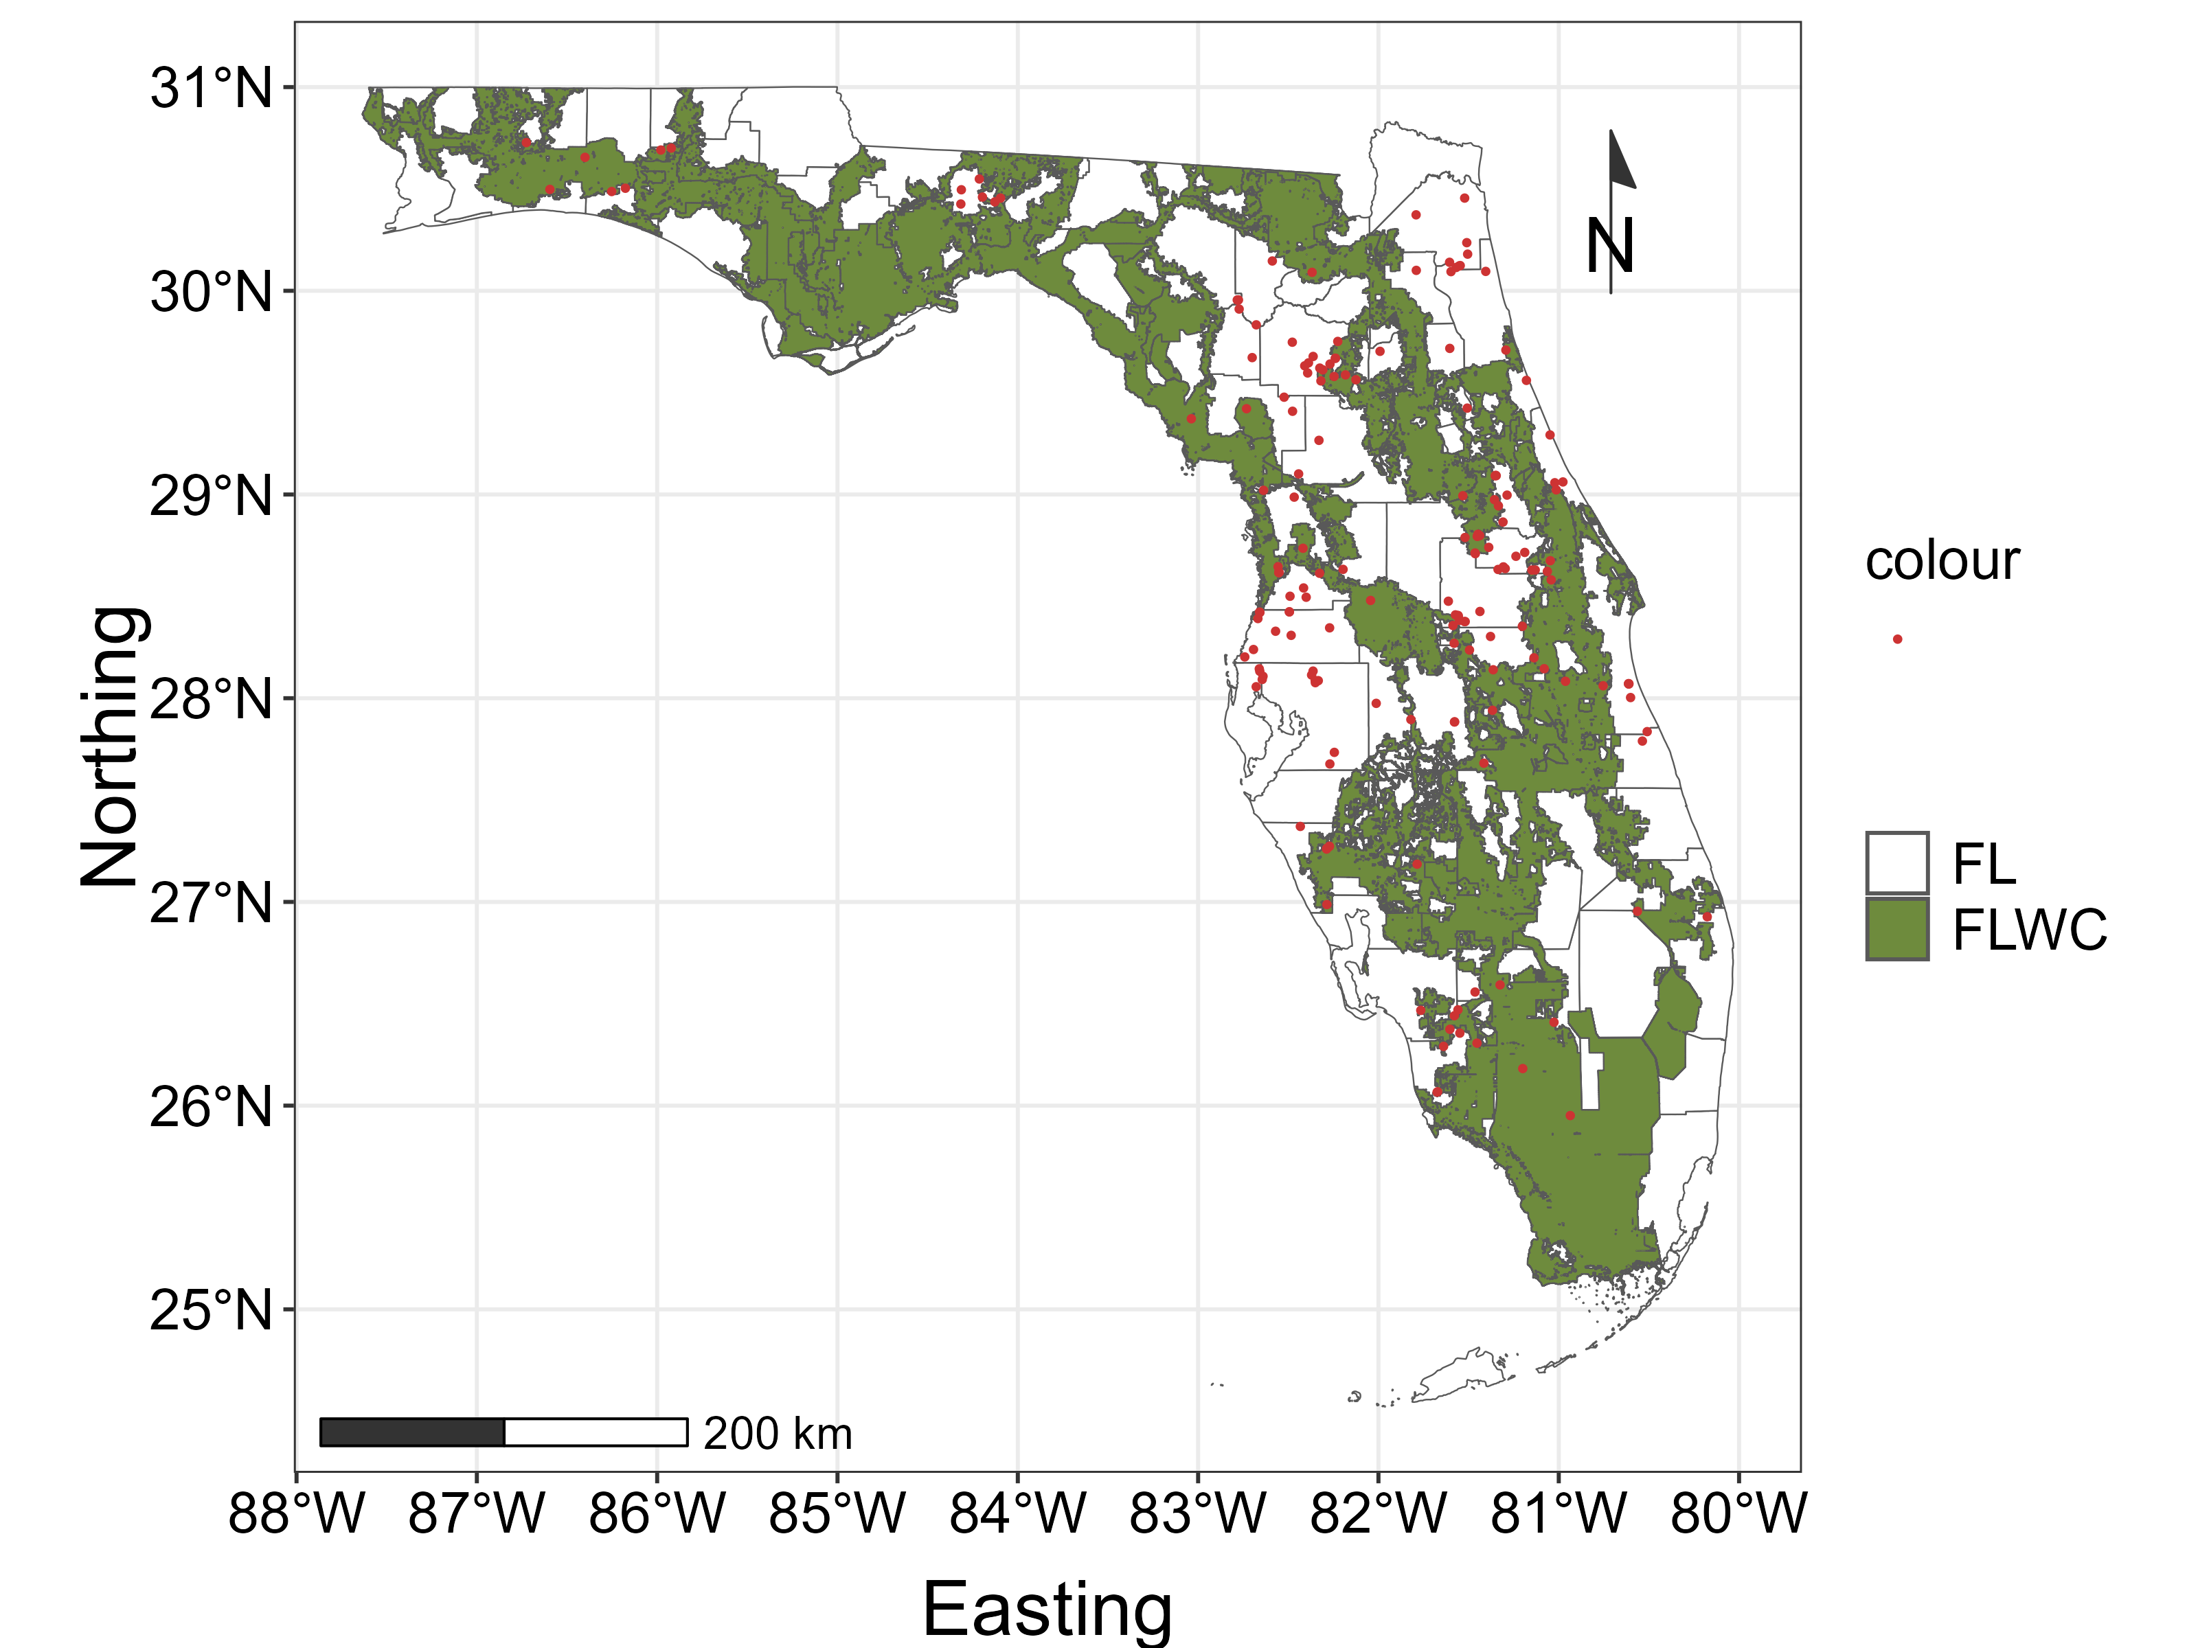
Presence only
(N=182)
Online biodiversity platform
Users upload photos/sound files
Provide lon/lat info

Slide 9
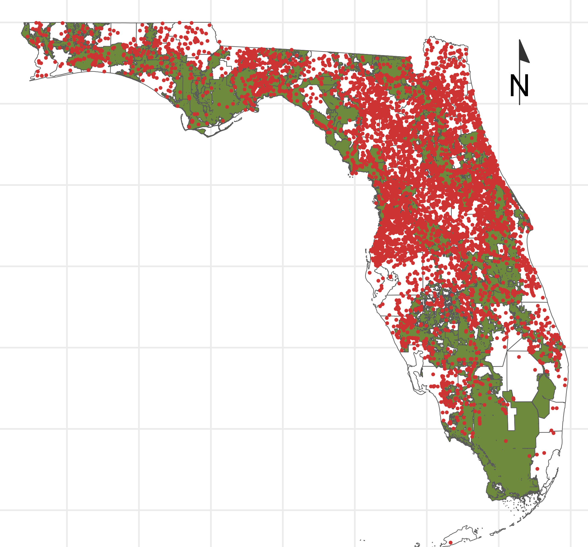

Counts
(N=5958)
Poult per hen surveys from 2020
Brood counts
Demographic information

Slide 10
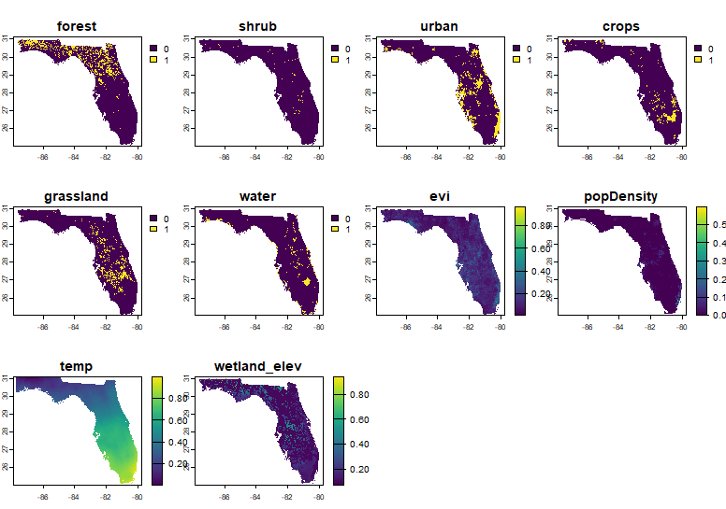
Environmental variables
Veg cover influence hab selection
Human=direct /indirect impacts
Climate=impact productivity

Slide 11
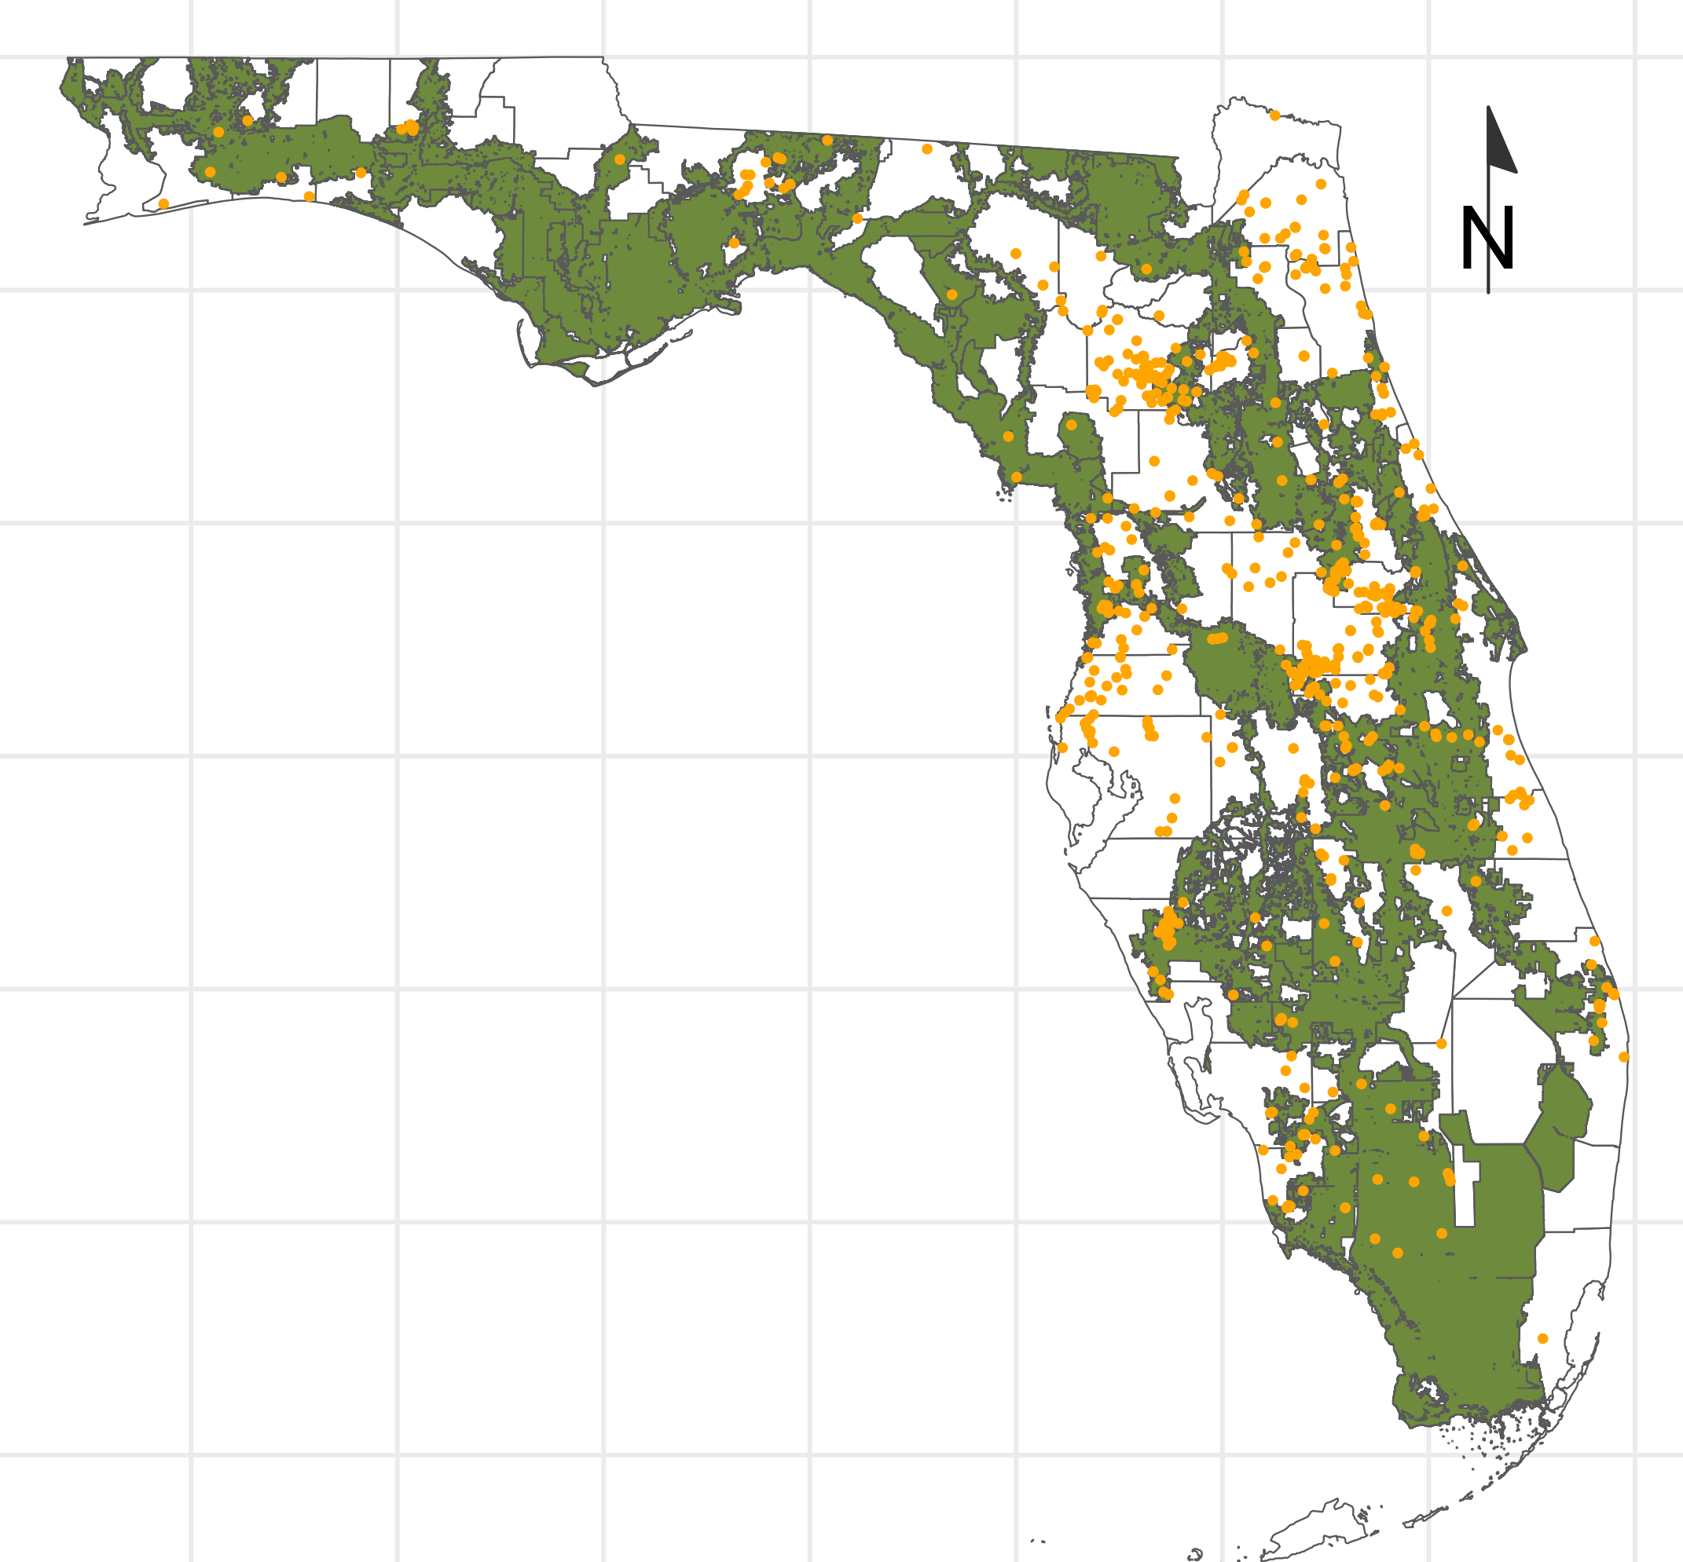
Models
Presence/Non-detection
Presence only
Counts
Occupancy model
Integrated model
Regression models=variability within and outside FLWC
Occupancy
Relative abundance

Slide 12
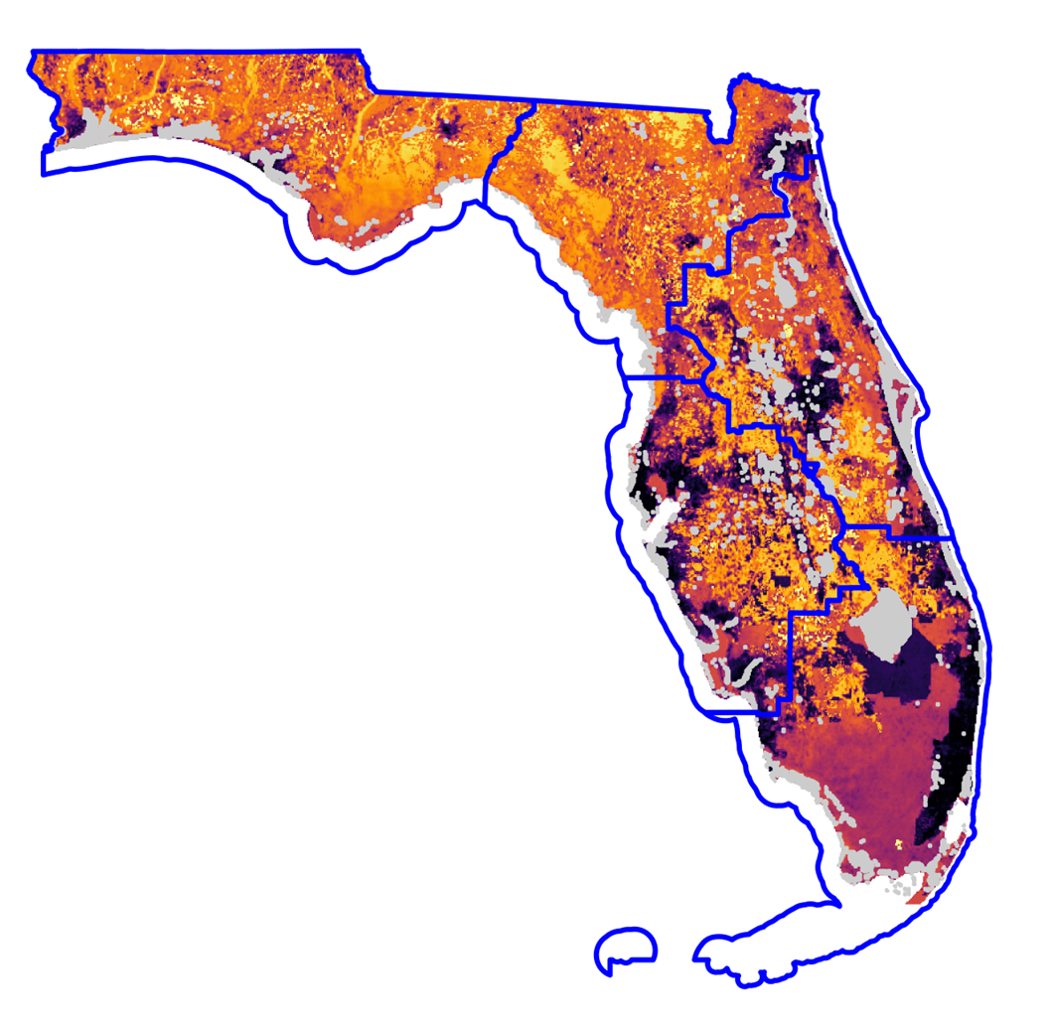

Results : Occupancy distribution
NW
NC
NE
High occupancy in NC & NW
Various in NE & SW
Low in south Florida
SW
Water
S

Slide 13
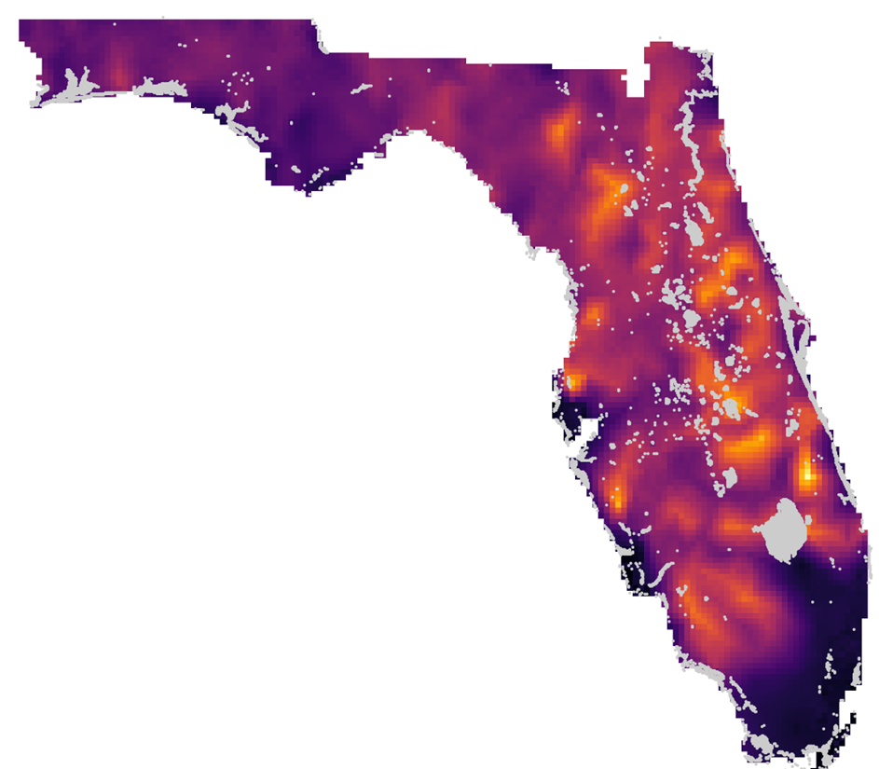
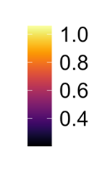
Relative abundance
NC
NW
NE
High abundance in NC & NE
Low in NW & South FL
SW
S

Slide 14
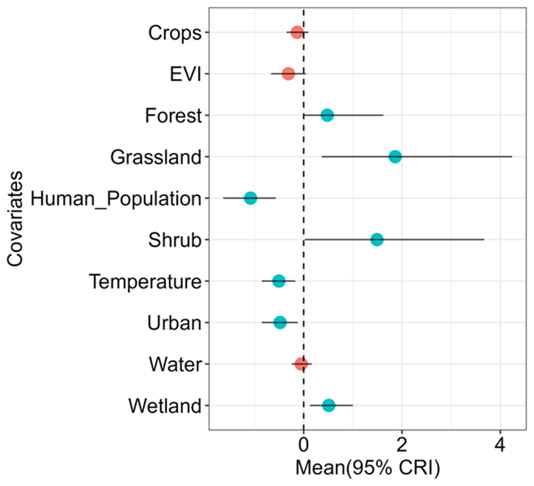
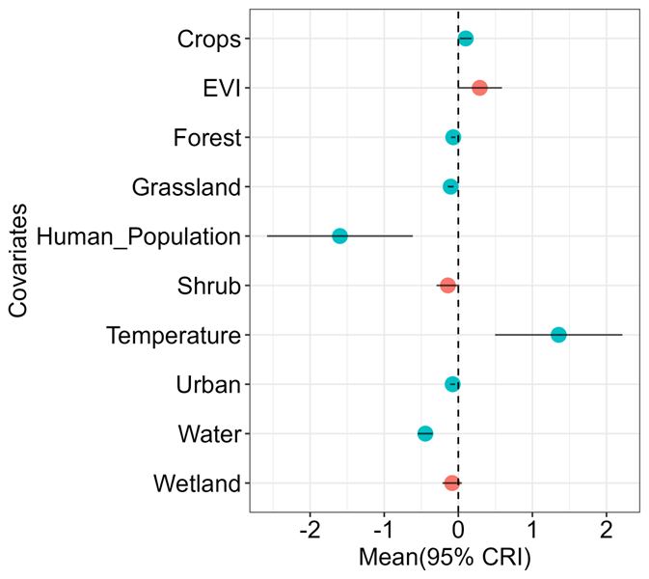
Urbanization and human population reduce both occupancy and abundance
Temperature reduce occupancy and increase abundance
Vegetation cover increase occupancy
Occupancy effects
Relative abundance effects

Slide 15
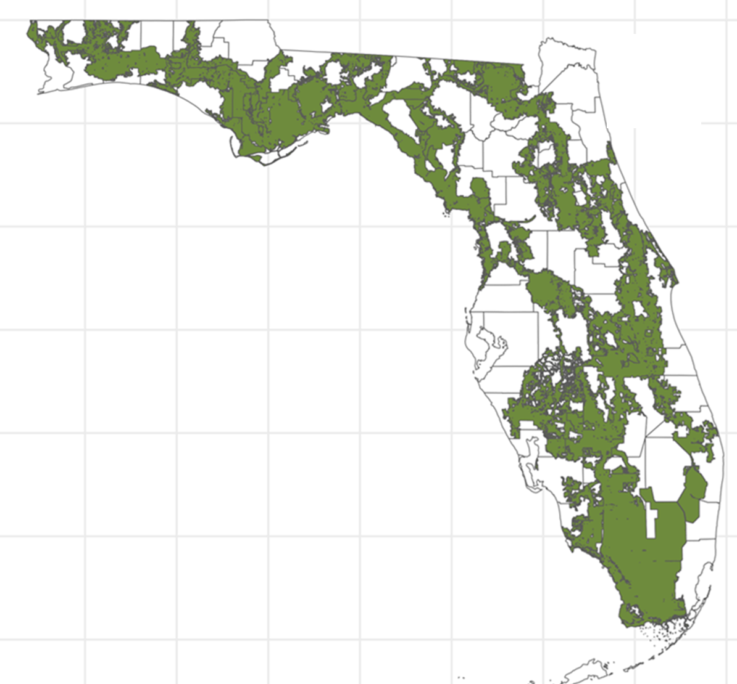
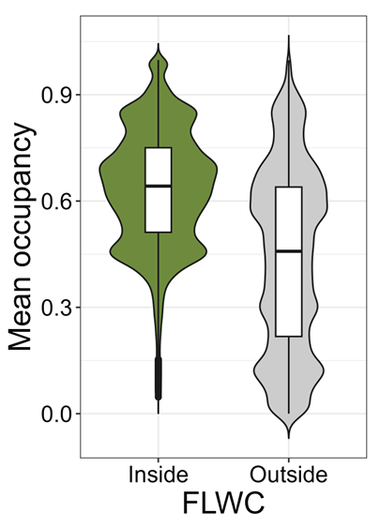
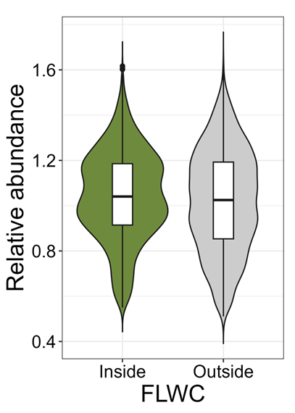
Occupancy = sig high inside FLWC
Relative abundance = sig high inside FLWC
Occupancy
Relative abundance

Slide 16
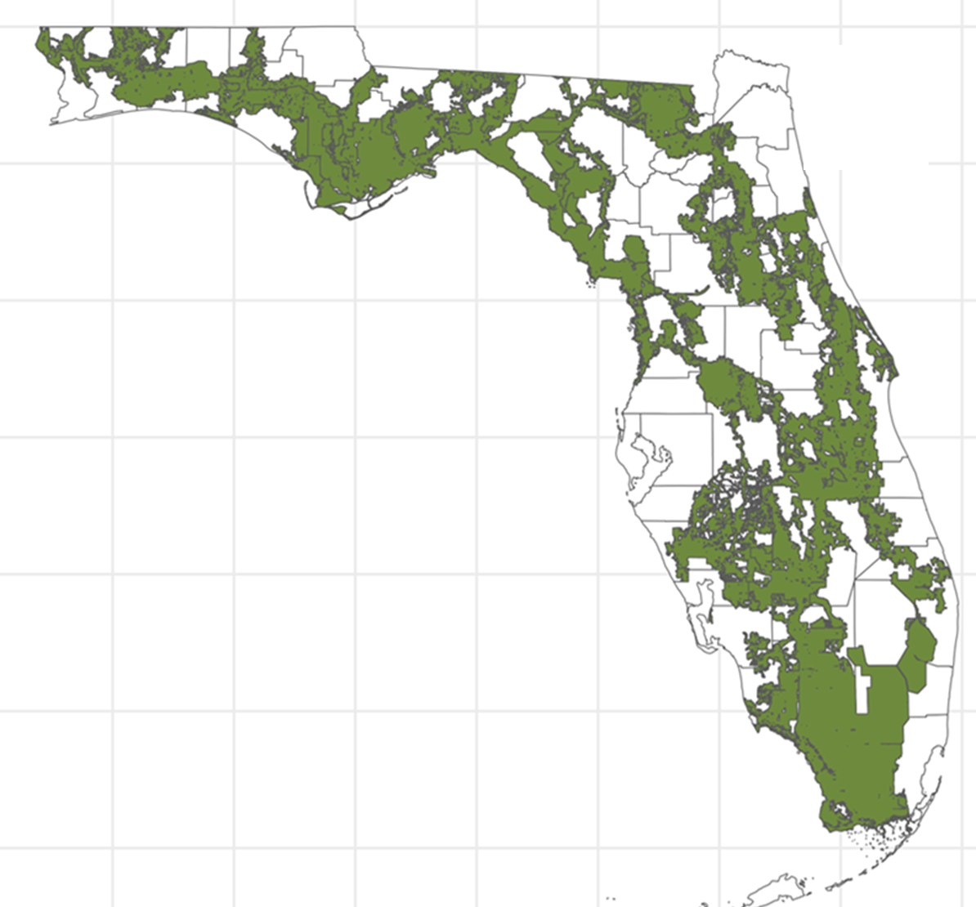
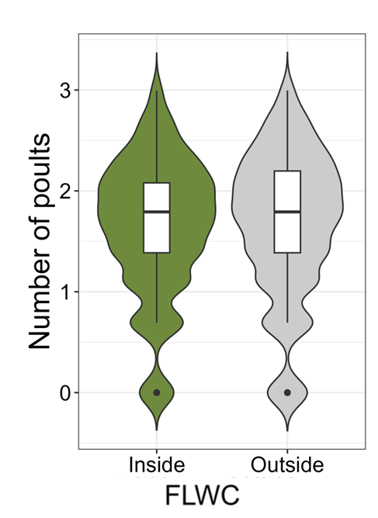
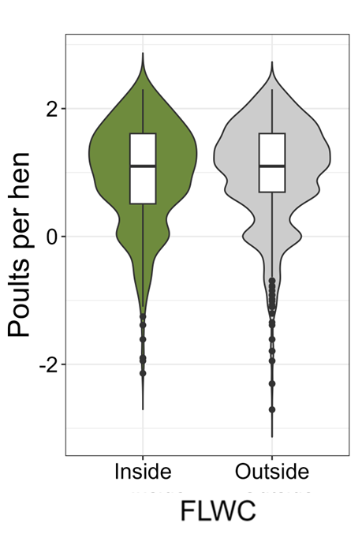
#poults & poult per hen = similar inside/outside FLWC
Number of poults
Poults per hen

Slide 17
Discussion
FLWC may protect suitable turkey habitat
Urbanization/hum pop impacts turkey conservation
Successful conservation= maintenance of habitat inside the FLWC

Slide 18
Conclusion
FLWC Act may protect critical habitat
Critical for endemic Osceola in peninsular FL
Turkey habitat available outside the FLWC
Structured surveys to compliment citizen data

Slide 19





Acknowledgements
Angeline Meeks
Bobbi Carpenter
Juliana Ofalt
Emma Zietler

